Slide 1
COMP 3617
Week 4

Slide 2
Agenda
ImageView
Adapters
AutoComplete
Spinner
ListView
ListActivity
ActionBar & Menus

Slide 3
Image View
Displays images
Images packaged with the app are placed in one of the res/drawable folders and the src property is used to assign it
Folders use device-configuration scheme to provide different versions of each resource image for mipmap-mdpi, mimmap-hdpi, mipmap-xhdpi etc
Each folder represents resolutions of the device
ScaleType property enables different effects to the image. Eg: center, fitCenter

Slide 4
Image View
Not necessary to include resource image for every resolution
Android displays the best match and performs scaling (but sometimes this may not be exact as you want it to be)
Use nodpi suffix to let Android know that you do not want images to be scaled to match the screen density

Slide 5
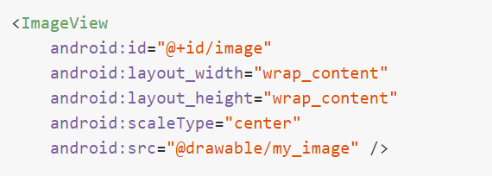
Image View
ScaleType attribute determines how the images are scaled to fit in the layout
Eg: Setting the scaleType=“center” makes the image centered in the view regardless of the size of view

Slide 6
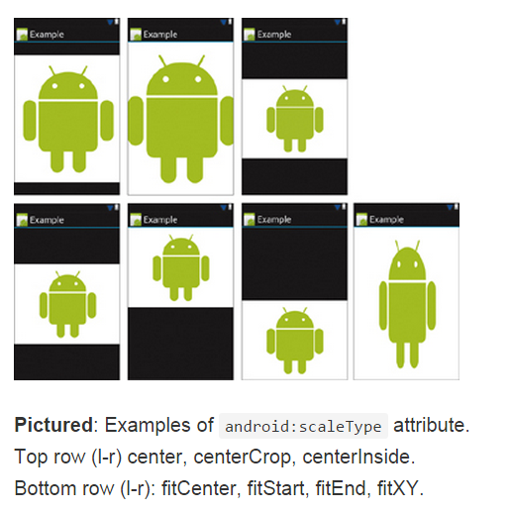
Image View Scale Type
Notes:
Note in the last fitXY – the image is distorted. There is a property called adjustViewBounds. Set it to true and aspect ration will be maintained

Slide 7
Image View
To create resource images for different densities, it is typical to create an extra high density image and use a tool to generate the image for other densities
Tools to create images are Photoshop and Illustrator for vector graphics
One such tool is called Final Android Resizer
Another online tool is called AndroidAssetStudio (https://romannurik.github.io/AndroidAssetStudio/index.html)

Slide 8
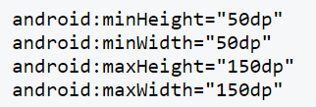
Image View
Size of the ImageView is by default determined by the graphics dimensions
Specific minimum and maximum height/widths can be specified using the following attributes
This does not however preserve the aspect ratio. To allow for that set the adjustViewBounds property to true as well

Slide 9
Adapters
Provide a common interface to the data model
Special classes that act as a bridge between data and the certain types of views
Adapters pull content from a source such as an array, database etc
Adapters convert each item data into a view that is displayed in the list
Views that are sub-classes of AdapterView use an adapter to bind to its layout
Common Adapter – ArrayAdapter

Slide 10
Adapters
Data
View
Adapter
AutoComplete
Spinner
ListView
Layout
Defines the common user interface for each element of the data

Slide 11
Array Adapter
Simplest adapter that encapsulates a Java array or java.util.List
Adapter typically takes three arguments
Context – just pass the current activity instance
ResourceID – View to use to display a single data item – can be built-in resource ID
Array or List of items to display
Default implementation calls the toString() method on each item to set the ResourceID’s content

Slide 12
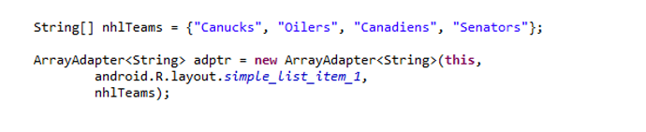
Array Adapter
Example Usage
Notice the second argument is spelt out as “android.R.layout.simple_list_item_1”
It refers to a TextView layout that is already defined in the system – hence the prefix android.R

Slide 13
AutoCompleteTextView
Provides the auto complete functionality for a text view
As the user types in the text view the control can display suggestions for selection
Property android:completionThreshold indicates the minimum number of characters to be entered for list filtering
To provide the list of suggestions you make use of an adapter that encapsulates an arraylist

Slide 14
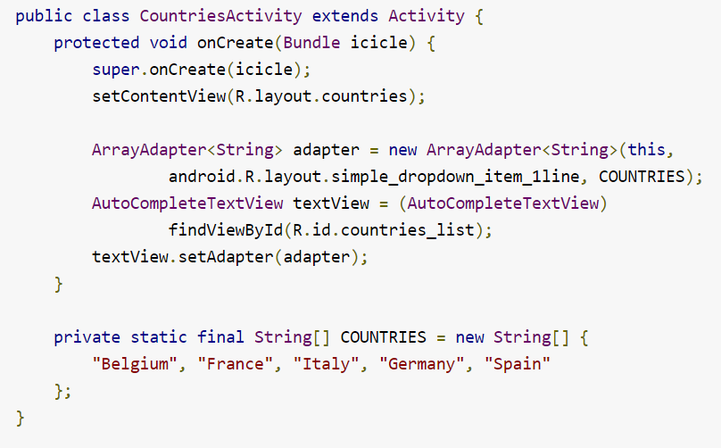
AutoCompleteTextView

Slide 15
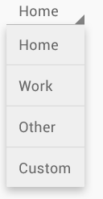
Spinner
Allows for selection of one item from a set
Used to select from a short list of choices
Populating a spinner involves an adapter
Common for the adapter to get the list of choices from a resource file

Slide 16
Spinner
An ArrayAdapter can be used to populate a spinner with data from a string resource file
ArrayAdapter has a static method createFromResource() that can be used to create an ArrayAdapter from the string-array resource
Spinner uses two views – one for the normal mode and the other for pop-up list mode
Attribute prompt on the spinner is used to set the prompt at the top of the list

Slide 17
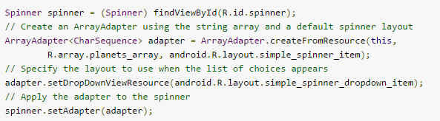
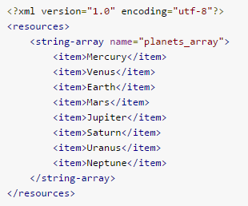
Spinner

Slide 18
ListView
A common AdapterView to display a list of items
Displays a scrollable list of items
Items are retrieved via Adapters
There is a conversation that happens between the ListView and the ArrayAdapter
ListView
How many items?
Array Adapter
5
Give me view for 1
Conversation continues for as many items as required
Here you go

Slide 19
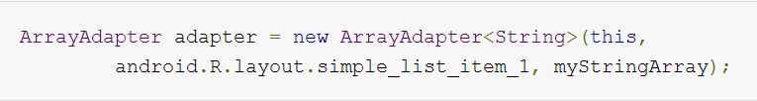
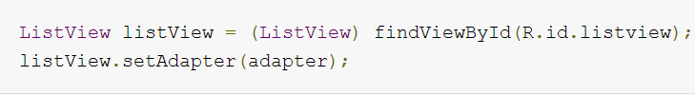
ListView and ArrayAdapter
Create an Adapter
Layout resource for each item of the data
Data Source (an array)
Assign an Adapter with the ListView

Slide 20
List Activity
An activity that hosts a ListView
Has a default layout that consists of a single, full screen list
No need to call setContentView in the activity’s onCreate method
Call setListAdapter() method in the onCreate method to associate the adapter
onListItemClick() will be called when an item is selected in the ListView passing in the ordinal position of the clicked item

Slide 21
Options Menu
Every Android project you create has an onCreateOptionsMenu method
It inflates (XML -> Java Objects) the menu items defined in menu resource file (main.xml)
Menu is rendered as an Action Bar on devices that support action bar
On devices that do not support the action bar, the items are rendered as menu items
Since in this class we cover Android API 14 and above, we will cover Action Bar

Slide 22
Action Bar
Added to the Android in 3.0 (API level 11)
Navigation panel at the top of every activity
Provides a consistent framework for navigation, branding and performing key actions at each activity level
Any activity can make use of the Action Bar
Enabled by default in any activity that uses the Theme.Holo and has a minimum SDK of 11 or higher
Can be hidden and shown programmatically

Slide 23
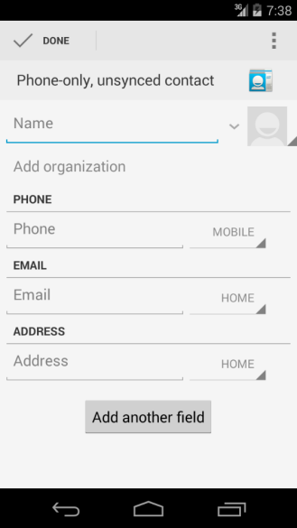
Different Bars…
Status Bar
Action Bar
System Bar

Slide 24

Action Bar
App icon
View Control
Action Button
Action Overflow

Slide 25
Action Bar
Right most icon on the action bar is called the (action) overflow button
Important action items can be configured to display directly on the action bar instead of being hidden in the overflow menu
Action item shown on the action bar is called an action button
Action button can have an icon, title or both
Icons for action bar are available from Google https://developer.android.com/design/downloads/index.html

Slide 26
Split Action Bar
Action Bar can be split to display a separate bar at the bottom
This allows for action items to be displayed at the bottom where running on a narrow screen
To split the action bar, add uiOptions=“splitActionBarWhenNarrow” attribute to activity or the application in manifest file

Slide 27
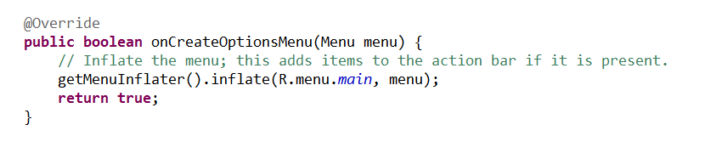
Creating a Menu
Override the onCreateOptionsMenu callback method in the Activity

Slide 28
Defining Menu in XML
Menus can be constructed in code but its best practice to define them as XML resources
Menu resources are stored as XML files in res/menu folder
Each menu hierarchy must be created as a separate file
Each menu hierarchy starts with a root note menu and a series of item tags
Item tags define the menu item with text, icon, short cut and action providers

Slide 29
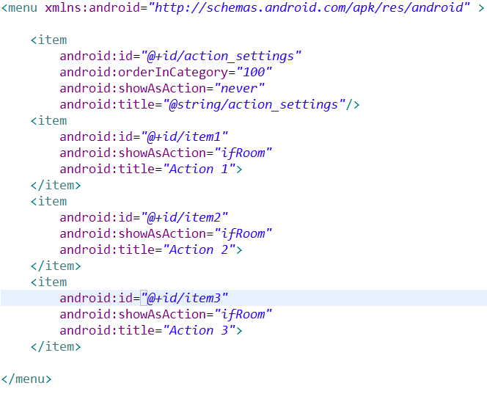
Defining Menus in XML

Slide 30
Menu Item
Each item contains id, showAsAction, title and other attributes
If there are too many items, some items can be accessed via the overflow menu option (shown as 3 vertical dots icon)
showAsAction attribute determines how to show the menu items in action bar
Value | Description
never | Never show the item in action bar
ifRoom | Show when there is room
withText | Show with text.
always | Show always

